Slide 1

Python: Getting Started
INTRODUCTION
Bo Milanovich
PYTHON WIZARD
@pythonbo pythonbo.com

Slide 2
Python: Getting Started
Python basics – data types, functions, classes
Simple, beautiful, powerful and cross-platform
Python all the things!

Slide 3
What Makes Python so Amazing?

Slide 4






Using Python
Automation
Science
Desktop
Android
Web
Machine Learning

Slide 5
My Uses of Python
Cross-platform desktop application with Qt
Django and Flask web apps Home automation with Python

Slide 6

Python vs The Others
// Java
public class HelloWorld {
public static void main(String[] args) { System.out.println("Hello World")
}
}
# Python 3 print("Hello World")

Slide 7
Python 2 vs Python 3

Slide 8
Python 2 vs Python 3
Python 2
Maintained, but no new features End of Life (EOL) in 2020 Still default on many systems print “Hello World”
Python 3
New features being added Unicode support by default Cleared some Python 2 confusion print(“Hello World”)
Minor differences from Python 2

Slide 9
Installing Python

Slide 10
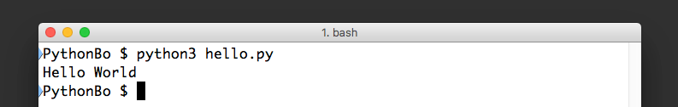
Running a Python Program
# hello.py file contents print(“Hello World”)

Slide 11
Installing PyCharm

