Slide 1


Types, Statements and Other Goodies
Bo Milanovich
PYTHON WIZARD
@pythonbo pythonbo.com

Slide 2

Module Overview
Data Types
Flow Control Loops Dictionaries Exceptions
Other Data Types

Slide 3
Types in Python – Wait, What?

Slide 4
Python vs. the Others… again
// C# or Java int answer = 42;
String name = "PythonBo”;
# Python answer = 42
name = "PythonBo"

Slide 5
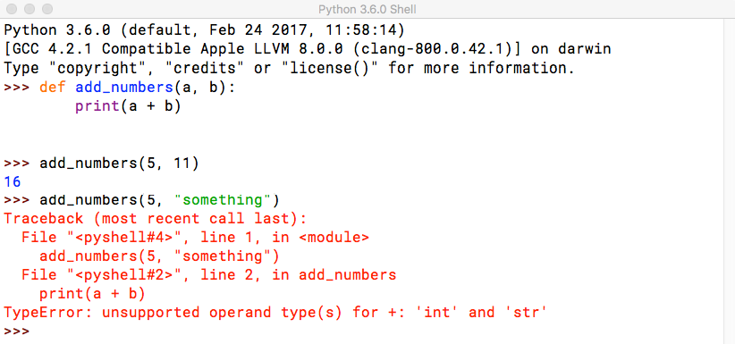
Combining Data Types

Slide 6
Type Hinting
def add_numbers(a: int, b: int) -> int:
return a + b

Slide 7
Integers and Floats
answer = 42
pi = 3.14159
answer + pi = 45.14159 int(pi) == 3
float(answer) == 42.0
# Don’t worry about conversion!

Slide 8
Strings
'Hello World' == "Hello World" == """Hello World""" "hello".capitalize() == "Hello" "hello".replace("e", "a") == "hallo" "hello".isalpha() == True
"123".isdigit() == True # Useful when converting to int "some,csv,values".split(",") == ["some", "csv", "values"]

Slide 9
String Format Function
name = "PythonBo"
machine = "HAL"
"Nice to meet you {0}. I am {1}".format(name, machine) f"Nice to meet you {name}. I am {machine}"

Slide 10
Boolean and None
python_course = True java_course = False int(python_course) == 1
int(java_course) == 0 str(python_course) == "True"
aliens_found = None

Slide 11
If Statements
number = 5
if number == 5: print("Number is 5")
else:
print("Number is NOT 5")

Slide 12
Truthy and Falsy Values
number = 5
if number:
print("Number is defined and truthy")
text = "Python" if text:
print("Text is defined and truthy")

Slide 13
Boolean and None
python_course = True
if python_course: # Not python_course == True print("This will execute")
aliens_found = None if aliens_found:
print("This will NOT execute")

Slide 14
Not If
number = 5
if number != 5:
print("This will not execute")
python_course = True if not python_course:
print("This will also not execute")

Slide 15
Multiple If Conditions
number = 3
python_course = True
if number == 3 and python_course: print("This will execute")
if number == 17 or python_course: print("This will also execute")

Slide 16
Ternary If Statements
a = 1
b = 2
"bigger" if a > b else "smaller"

Slide 17
Lists
student_names = []
student_names = ["Mark", "Katarina", "Jessica"]

Slide 18
Getting List Elements
student_names = ["Mark", "Katarina", "Jessica"]
student_names[0] == "Mark" student_names[2] == "Jessica" student_names[-1] == "Jessica"

Slide 19
Changing List Elements
student_names = ["Mark", "Katarina", "Jessica"]
student_names[0] = "James"
student_names == ["James", "Katarina", "Jessica"]

Slide 20
List Functions
student_names = ["Mark", "Katarina", "Jessica"]
student_names[3] = "Homer" # No can do! student_names.append("Homer") # Add to the end student_names == ["Mark", "Katarina", "Jessica", "Homer"] "Mark" in student_names == True # Mark is still there! len(student_list) == 4 # How many elements in the list del student_names[2] # Jessica is no longer in the list :( student_names = ["Mark", "Katarina", "Homer"]

Slide 21
List Slicing
student_names = ["Mark", "Katarina", "Homer"]
student_names[1:] == ["Katarina", "Homer"] student_names[1:-1] == ["Katarina"]

Slide 22
Demo
Break and Continue

Slide 23
Printing List Elements
student_names = ["Mark", "Katarina", "Jessica"] print(student_names[0]) print(student_names[1]) print(student_names[2])
...

Slide 24
For Loop
for name in student_names:
print("Student name is {0}".format(name))

Slide 25
Other Code
for (var i = 0; i < someArray.length; i++) {
var element = someArray[i]; console.log(element);
}

Slide 26
While Loops
x = 0
while x < 10:
print("Count is {0}".format(x)) x += 1

Slide 27
Infinite Loops
num = 10
while True:
if num == 42: break
print("Hello World")

Slide 28
Dictionaries
student = {
"name": "Mark", "student_id": 15163, "feedback": None
}

Slide 29
List of Dictionaries
all_students = [
{"name": "Mark", "student_id": 15163 },
{"name": "Katarina", "student_id": 63112 },
{"name": "Jessica", "student_id": 30021 }
]

Slide 30
Dictionary Data
student["name"] == "Mark"
student["last_name"] == KeyError student.get("last_name", "Unknown") == "Unknown" student.keys() = ["name", "student_id", "feedback"] student.values() = ["Mark", 15163, None] student["name"] = "James"
del student["name"]

Slide 31
Demo
Exceptions

Slide 32
Other Data Types
complex
long # Only in Python 2 bytes and bytearray tuple = (3, 5, 1, "Mark") set and frozenset
set([3, 2, 3, 1, 5]) == (1, 2, 3, 5)

Slide 33
Data types
Lists Dictionaries
For and while loops Exception handling
Summary

